Slide 1
Image Art Style Classification using CNN
AML S.C.E
Faculty – Disha Wankhede Ma’am

Slide 2
Submitted By -
Name | Roll No. | Div | PRN
Sanghamitra Janrao | 322056 | B | 22111231
Aquif Shaikh | 324003 | D | 22111056
Hrithik Narote | 324078 | D | 22011055

Slide 3
Table of contents
01
02
03
04
Introduction
Model Implementation
Result and Evaluation
Conclusion

Slide 4
01
Introduction

Slide 5
The objective of this project is to classify images based on their art style using a Convolutional Neural Network (CNN).
The dataset consists of two art styles:
Rembrandt and Van Gogh, with each class containing 20 images. The project is implemented using TensorFlow and Keras in the Google Colab environment.

Slide 6
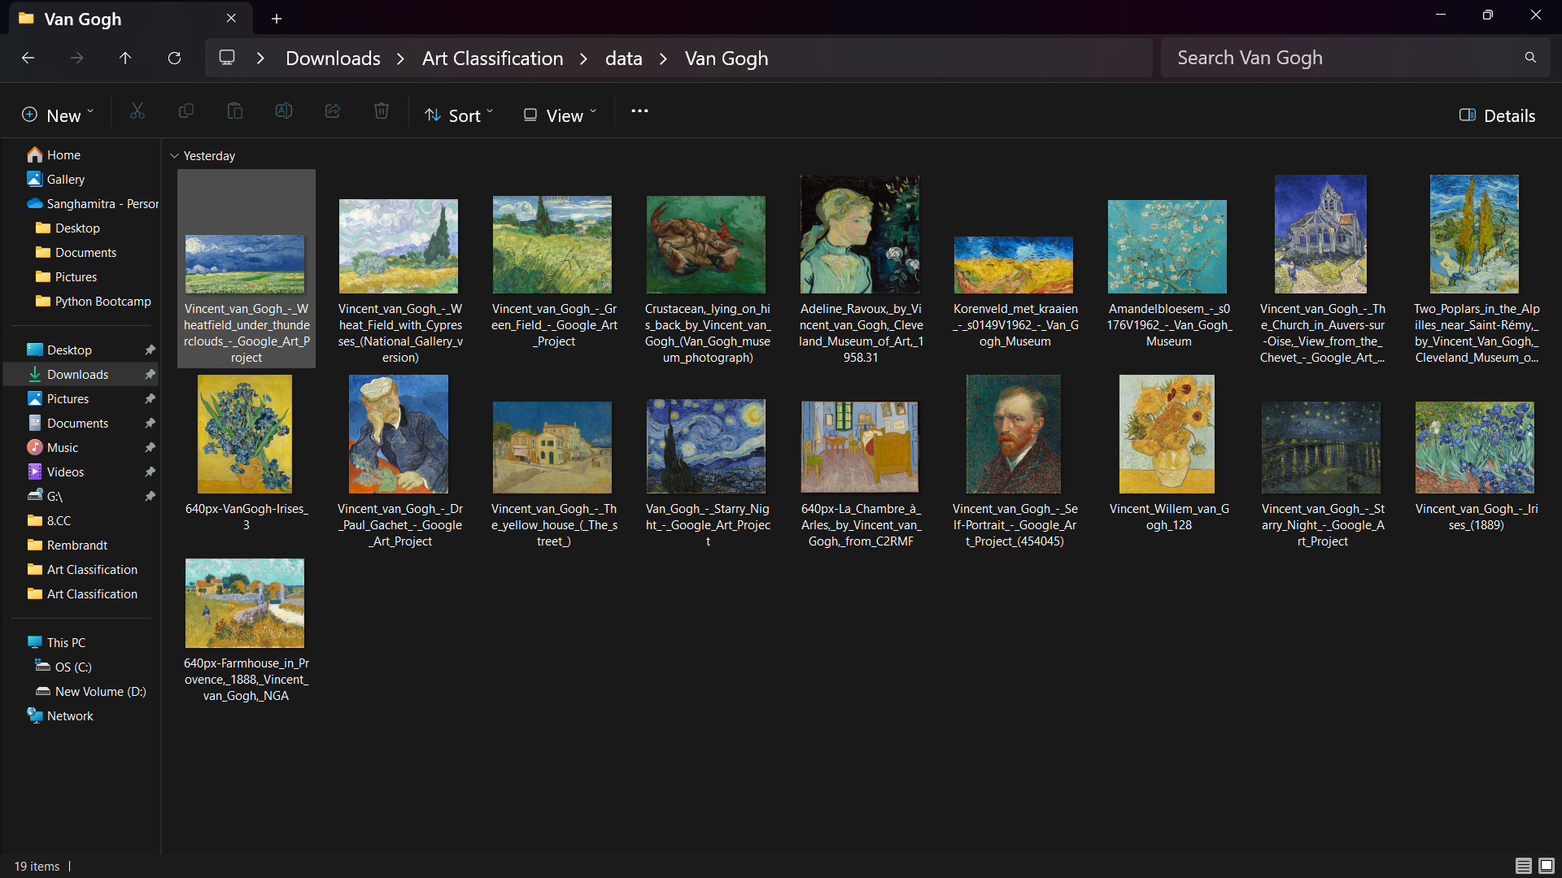
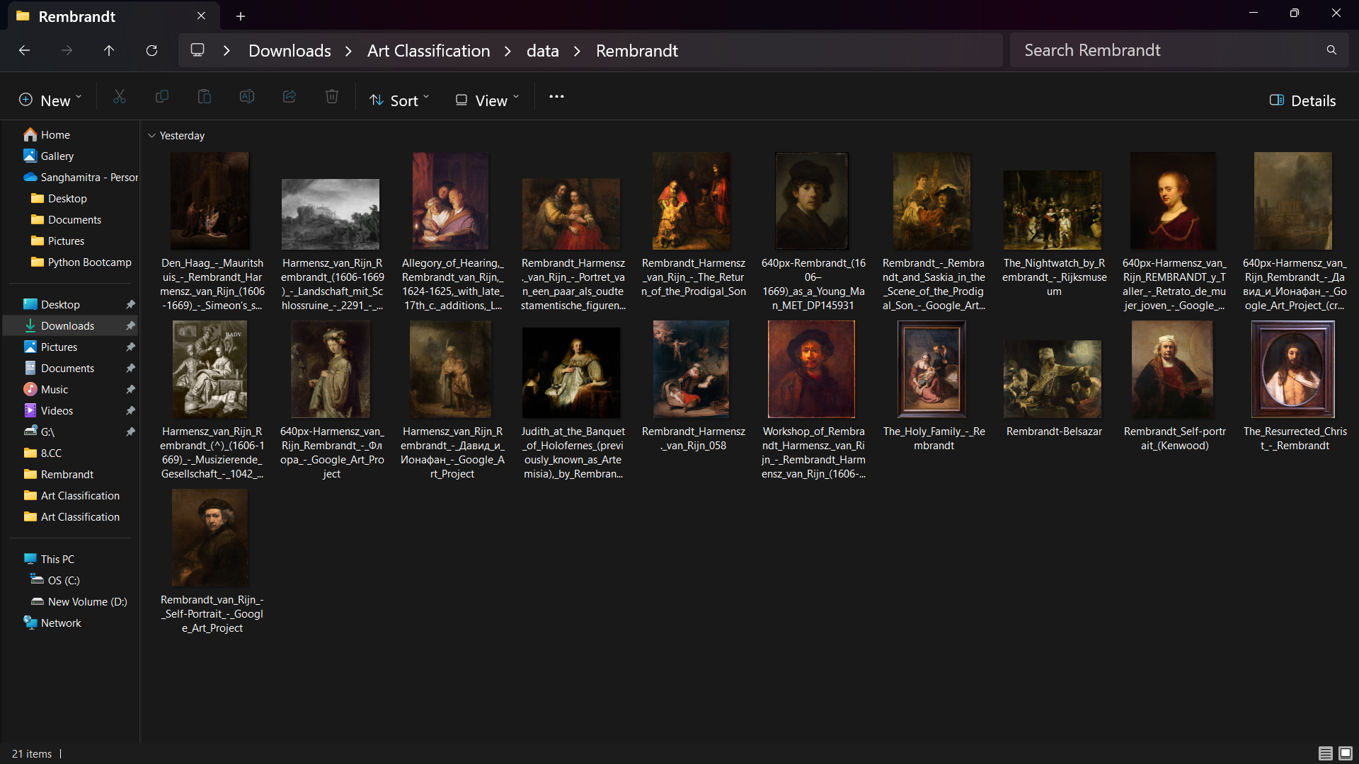
Data -

Slide 7
02
Model Implementation

Slide 8
Data Preprocessing
Dodgy images are removed from the dataset
Rescaling are applied to preprocess the images.
Dataset is then split into training and validation sets.

Slide 9
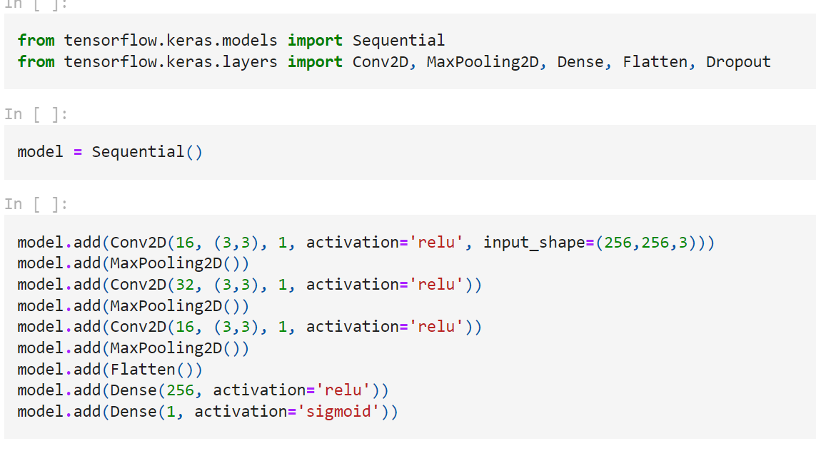
Model Architecture
The CNN model architecture consists of three convolutional layers followed by max-pooling layers to reduce spatial dimensions. The flattened output is passed through two fully connected (dense) layers with ReLU activation. The final output layer uses sigmoid activation for binary classification.

Slide 10
03
Result and Evaluation

Slide 11
Model Training
The model is compiled using the Adam optimizer and binary cross-entropy loss function. It is then trained for 20 epochs using the training data, with validation performed on the validation set
Performance Evaluation
The performance of the trained model is evaluated using precision, recall, and binary accuracy metrics.

Slide 12
04
Conclusion

Slide 13
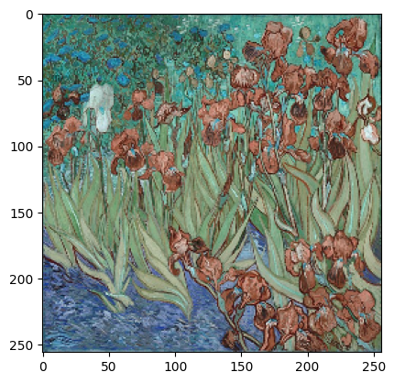
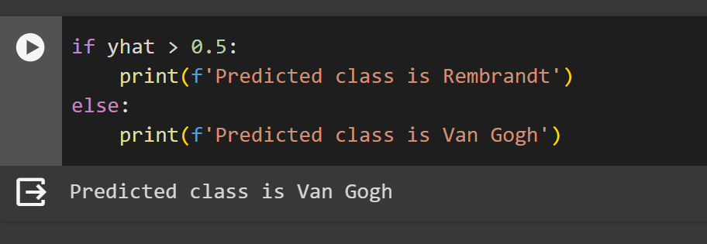
In conclusion, this project demonstrates the process of building and training a simple CNN model for art style classification. The model achieves satisfactory performance in classifying images into Rembrandt and Van Gogh styles.

Slide 14
thank you.

